Slide 1

Back To Basics
Advanced Training for Research & Projects Directors

Slide 2
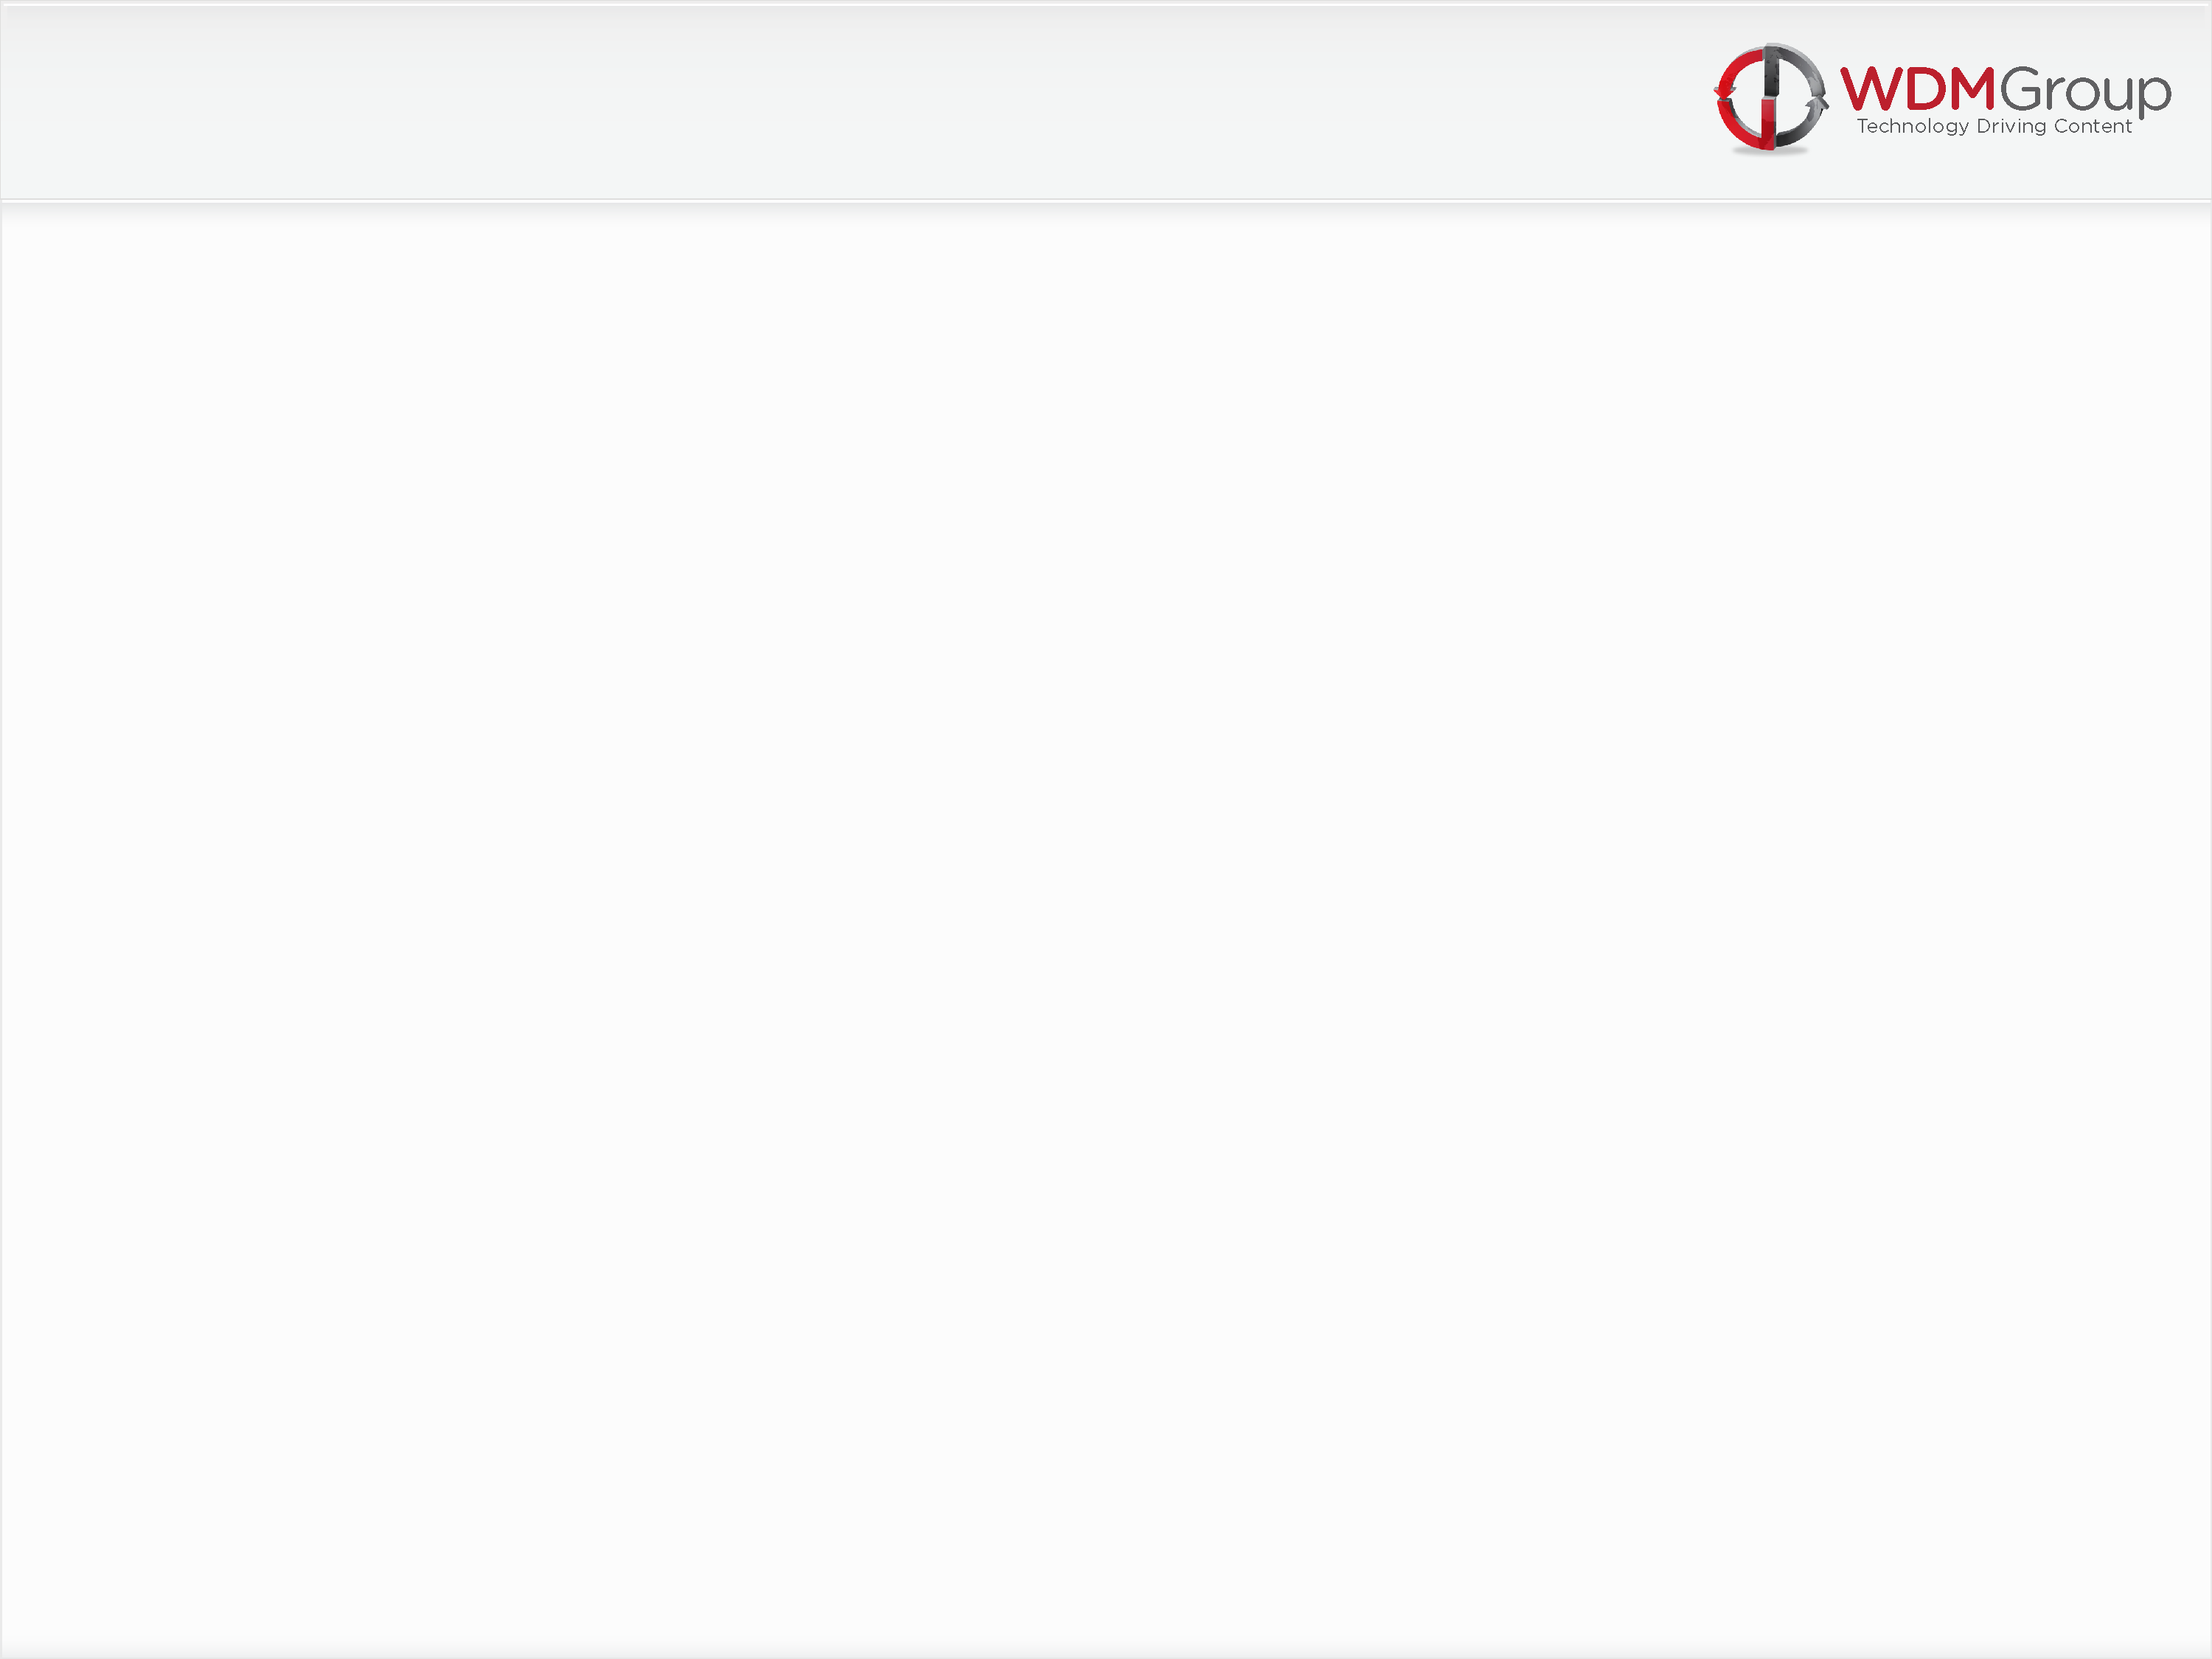
Back To Basics
Attitude & Application
Preparation (LHA’s)
Activity
Suspects (Hand Written)
Prospect (Cold Edit)
Executive List Delivery (P2)
PM Call (P1)
Qualification
Maximisation/Optimisation
Sales File Set-Up (Crib Sheet/Sign Off)

Slide 3
Attitude & Application
Positive Motivation from Management
Positivity from all Call Centre staff
Hunger and Desire to succeed
Work Ethic – 2 to 5 hours a week dedicated to Research and Lead generation – without fail!
Team Players at all times
Research Directors to strive for £15,000/$24,000 plus per month
Projects Directors to strive for £7,500/$12,000 personal revenue per month
Hit your Activity and LHA targets and the rest will fall into place!

Slide 4
Preperation
Understand your Sector/Territory – Spidergram & iGram
Know your Production Schedule
Know your Editorial calendar – “Putting the spotlight on...”
Take an interest in the latest news – Set up Google alerts for one off ‘hot’ leads
Use your own industry website for latest news and ‘hot topics’
3 Month Planners – Require a minimum 6 Associations and/or Exhibitions, Media Partner contact details, 500 + available Leads and 3 Strong Angles per project
Lead Spreadsheet Management – To comply with the company standard spreadsheet and emailed weekly – All relevant/highlighted fields to be complete

Slide 5
Activity
Daily Activity:
4 Sessions
3 Hours
100 Calls
Session 1: – 40 Calls, 1 Hour and at least 1 Suspect
Session 2: – 25 Calls, 45 Mins, at least 1 Prospect
Session 3: – 40 Calls, 1 Hour and aim for another Suspect!
Session 4: – Whatever you need to do to hit your daily targets – 25 Calls & 30 Minutes minimum!

Slide 6
Session 1 & 3
Suspect Bonanza!
Lead Spreadsheet, Suspect Pad & Telephone only!
No other distractions!
Know your lines – The ‘Elevator Pitch’!
Dial & Smile – Sound bright and enthusiastic but not scripted!
40 calls and 1 hour of Activity as a minimum requirement.
1 Suspect, hand written, before end of Session 1 – Every morning!
Set personal goals and targets – Don’t be satisfied with less!

Slide 7
Session 2
Prospects –
Calendar appointments set from previous days Suspects
Follow up/chase any missed appointments or overdue calls – Note: Good buy in at Suspect stage should keep these calls to a minimum.
25 calls and 45 minutes of Activity as a minimum requirement
Make use of every opportunity! – Get back on to Suspects once all Prospects contacted
Turn around P3’s –
Not an ‘open ended’ invitation
Work to deadlines and Editors decision
Find Decision Maker if you have ‘pitched’ the wrong guy!

Slide 8
Suspect (Hand Written)
Engage the decision makers only, not marketing or sales executives
Upbeat introduction full of energy and enthusiasm
Use ‘ice breakers’ and a sense of humor - You are the tour guide to their WDM experience!
Build a personal/professional relationship
Ask intelligent questions and make detailed notes using the TF2SF strategy
Highlight emphasis of editorial meeting in decision making process
Close the suspect with a timeframe commitment for the Prospect
Send Suspect Follow Up email inc. links to suitable examples and the relevant website or magazine along with any testimonials available

Slide 9
Prospect (Cold Edit)
Re-establish relationship quickly and talk through the positive editorial decision, why the coverage fits for the readership and in line with our media partnerships
Explain the similar features recently completed, did they see your email and the magazine/website?
Confirm the interview procedure – Not time consuming, at their convenience and full editorial control
Company Profiles – where it goes and what they get as part of the major marketing exposure – Introduce 2nd magazine through our ‘Business Review’ channel
Product Explanation – fantastic exposure to an executive level readership as well as the production of a bespoke, corporate brochure, website archives, SEO and social networking opportunities
The digital corporate brochure delivery in PDF as a minimum 10 page customized brochure and the use of our innovative page turning technology improving their website users experience – A big chunk of their marketing budget if paid for or delivered by an agency!

Slide 10
Exec List Delivery (P2)
P2’s or Executive list deliveries are to be handled as an objection in the first instance – handle this based on time constraints, deadlines and not wanting to burden the Executive with administrative duties
Explain the need to liaise with a buyer or PM in order to ensure invitations delivered to all key partners across all areas of the TF2SF strategy - Plus, a database or accounts system is the easiest way to ‘cut and paste’ contacts onto our standard supplier spreadsheet.
Be polite but persistent in your approach to ‘flipping’ to a P1
If Executive insists that he will be preparing the lists ensure that a full PM process is followed – Enforce deadlines for list and letterhead delivery as well as the need for a minimum 20 – 30 contacts
P2 or Executive list deliveries can also benefit from a discussion about the contract size and ‘spend per annum’ – Highlight the need for all contracts above $75,000 pa
Be clear on the need for deadlines to be met and follow up with a Prospect contract confirming all project details – Attach relevant documents and copy in ‘Editor in Chief’ for added impact

Slide 11
PM Call (P1)
Introduction to the project and have they seen the email to the interview executive?
Explanation of the project and justification of the Hooks & Angles that prompted the profile set up
Explain the product offering and the size and scale of the editorial/marketing program
Introduce the fact that the Executive has approved our approach to vendors and the fact that we are to co-ordinate the data through the PM
Explain the full ‘supplier close’ approach, why and how we do the program
Direct the PM to view the ‘Vendor Guide’ to ensure they understand the coverage of TF2SF and why a full range of Vendors is important
Negotiate the timeframe and direct list delivery requirements and emphasize the importance of the production schedule
Arrange a suitable timeline as well as introduce the possibility of checking the data received – Maximization!

Slide 12
Maximization/Optimization
Rule Number 1: The first list received is never the correct list – Do not accept it with a ‘That will do’ attitude – Missed Vendors = Missed Commission!
Immediately make contact with the list provider – Be prepared with the supplier spreadsheet, your Suspect notes and a Vendor Guide in front of you
Thank the list provider for their efforts and then explain which areas of their supply chain you feel are missing from the list – Pay particular attention to Professional Services and IT
You may find that additional suppliers are available but handled by a separate department – In this instance take senior contact details and begin the PM process again
Update the Projects Director and the front of the Sales file.
Maximised/Optimized names can be worth a minimum 1 x Quarter page on each file

Slide 13
Qualification
Supplier list to be formatted to standard company spreadsheet and all fields to be completed
Ensure that all Vendor contacts are at a senior, decision making level
If the original contact is not the decision maker, aim to identify the decision making contact on site, preferably the MD/HOS - but only if based at the site!
If no MD or HOS? - Establish who is the most senior contact on site – By sending a fax/email to another site the recognition of the feature company can be lost and impact from a sales perspective diluted
Check for alternative numbers on all contacts – Cell/Direct line etc…
Correct Email addresses are an absolute priority on all lists
Attention to detail at this stage can add value to every sales file – Get it right first time!

Slide 14

James Pepper Group Training & Development Manager Email: james.pepper@wdmgroup.com Direct Line: 0044 (0)1603 217544 Fax: 0044 (0)1603 617082
View all of our products at our corporate site: WDM Group www.wdmgroup.com
112-114 Grosvenor House | Prince of Wales Road | Norwich | NR1 1NS

